Slide 1
Appendix C Soldier Responsibilities- E4-E5
1. Review promotion points in IPPS-A. If points are wrong/missing, submit supporting documentation to unit for updates
2. Once points are correct, validate points and promotion elections in “board preferences”
Soldier Responsibilities- E6-E8
1. Make board preference selections and validate in “board preferences”
2. Review and Validate ERB and ensure it is in iPerms
3. Review iPerms to ensure accuracy
4. (if needed) Submit a memo in iPerms to the president of the board to explain issues/errors
(Soldiers can do this from the link below on their smart phone)
https://ippsa.csd.disa.mil/

Slide 2
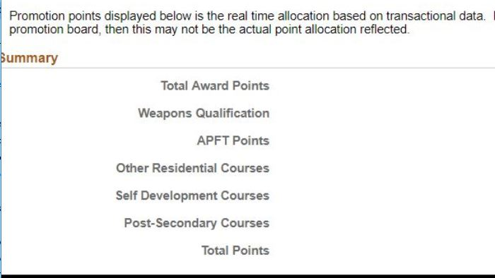
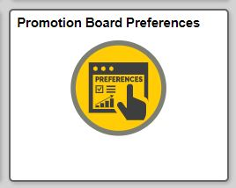
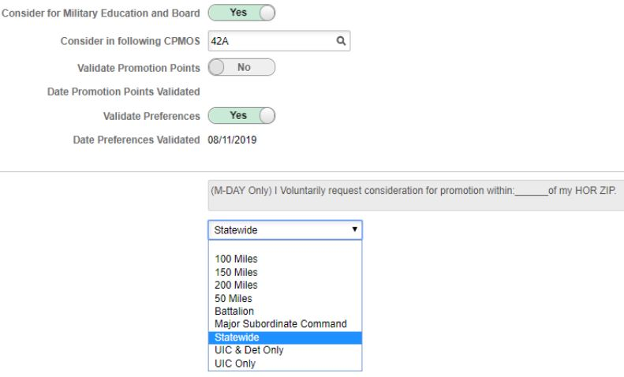
E4-E5 Being Considered
https://ippsa.csd.disa.mil/
3. Go to “board preferences”
(if tile not showing, just use the search function)
1. Search “promotion points”
2. Review current points
4. “Yes” to be considered for MILED and Board
(“No” if declining and skip to step 9)
5. Enter 3 digit MOS. Should be PMOS or DMOS (unless CPMOS change has been approved)
6. “Yes” to validate promotion points
7. “Yes” to validate preferences
8. Select mileage choice from drop down menu
(mileage is from RESIDENCE address on 5960 and shows as “mailing address” in IPPS-A)
9. Click “Save” and exit
*If promotion points aren’t correct, Soldier should wait for corrections before validating

Slide 3
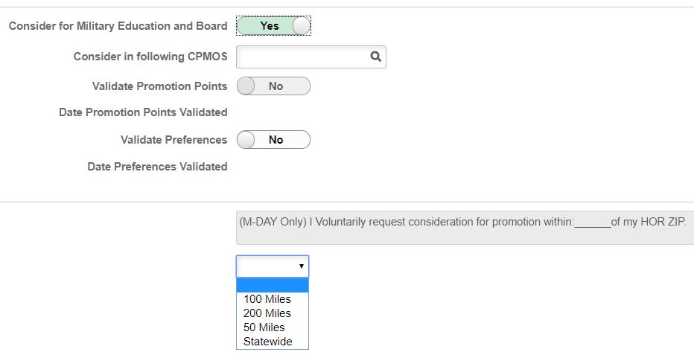
E6-E8 Being Considered
1. Go to “Board Preferences (if tile not showing, just use search function)
https://ippsa.csd.disa.mil/
2. “Yes” to be considered for MILED and Board
(“No” if declining and skip to step 6)
3. Enter 3 digit MOS. Should be PMOS or DMOS (unless CPMOS change has been approved)
4. “Yes” to validate preferences
5. Select mileage choice from drop down menu
(mileage is from RESIDENCE address on 5960 and shows as “mailing address” in IPPS-A)
6. Click “Save” and exit
*Soldiers still must ensure their ERB is updated/validated and loaded in iPERMS. Additionally, as per the MOI, Soldiers may submit to iPerms a memo addressing the president of the board for any discrepancies or missing items from their record.

